Slide 1
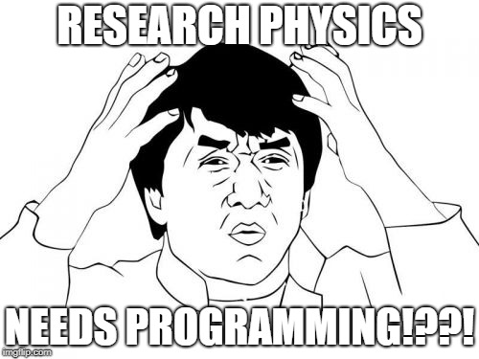
Technical Meeting: Software Development
The Zen of Python
Jupyter Notebooks
Responsibility should be unique
Programming is for gits

Slide 2
1. The Zen of Python (goo.gl/KubWVd)
Beautiful is better than ugly
Simple is better than Complex
Flat is better than nested
Readability counts

Slide 3
More important: PEP8
Python’s standard library style conventions
  Most, if not all, professional Pythons use it in their own code
Key insight: Code is read more often than it is written
  From experience: You can’t even read your own code down the road!
  Now imagine inheriting code from and old PostDoc from Russia 5 years ago…
Developers communicate (in code): use the same language (code style)!
If others use your code – they need to be able to understand it!
  For instance, to report bugs. Which we don’t make. Even so.

Slide 4
Jupyter Notebooks
More ‘notebook’ style working
Good for experimentation
Good for sharing (e.g. discussion about Z)
Can be rendered on GitHub (etc)
Downside:
  Usually: Unordered
  Usually: Unclear persistence of variables
  Obviously: You won’t make such mistakes

Slide 5
The Physicist Trap
Physicists define their symbols in math: e.g. r, x, g_munu
Trap: Call your variables the same
  Confusion – others do not have your notes!
  Conflicts! E.g. lambda is a defined keyword (anonymous function)
  Common variables change!
Instead, describe. Autocompletion is your friend!
  x: spatial_distance
  R: conformal_dimension
  G_munu: gravitational_tensor

Slide 6
2. Responsibility should be unique
A generic coding principle.
  “A class should have only one reason to change”
  “Gather together the things that change for the same reasons. Separate those things that change for different reasons”.
  See e.g. doi 10.1145/361598.361623
We’ve already thought of this, in many ways:
  Flowchart separates e.g. importing mathematica from optimizing the matrix
Continue to use it ☺
  E.g. a calculation optimization rarely has to know of the ‘physical objects’ it optimizes.

Slide 7
3. Programming is for Gits
But Josko, I don’t want to have so many files.
But, I won’t be able to find the function in the right file
But, what if we change things?
What if we all change things?
Wait, what did you change last week on Friday 15:21 when I wasn’t paying attention?
Did you do that?
Wait, what do we still have to do?
Aaah!

Slide 8
Version Control Software
Think of “save points” or “check points” in games. You’re able to go back to a previous point and continue.
Changes are recorded, and can be undone.
By keeping changes recorded, multiple changes by many people can be combined automatically.

Slide 9
On the history of Git
Long Ago, before I went to university, the Linux kernel used a proprietary software package for its development.
Then, the management changed and the relationship between the Linux developer community and the commercial company broke. As I heard it, the new management went “haha you have to pay now” and Linux went “Fuck that”.
Anyway, they made Git and it is now used by about 90-100% of developers.
Its goals:
  Speed
  Simple Design
  Strong support for non-linear development
  Fully distributed
  Able to handle large projects

Slide 10
Using Git
It’s a command line program.
Or use a graphical user interface, like GitHub provides.
Or don’t. Command lines are better anyway.
  Seriously, the command line offers more functionality than the more limited user interfaces do. That’s life.

Slide 11
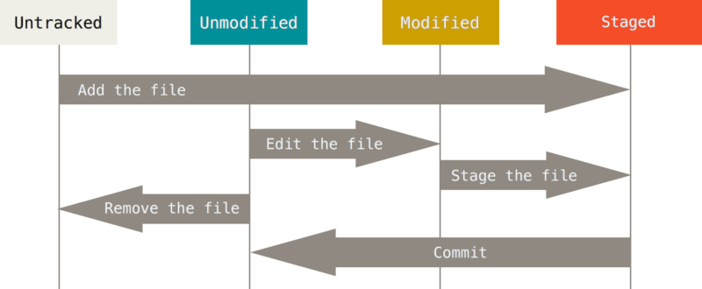
Git Basics: Recording Changes

Slide 12

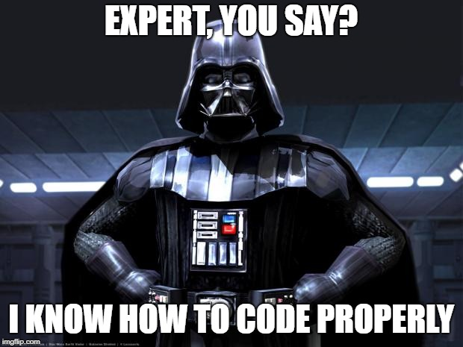
Conclusion
After mastery of
  The Zen of Pythons
  Singular Responsibility
  Being a Git
You’re able to become a Jedi Master. Alternatively, to make “good” code.
⬅ This was basically how I got a PhD spot

